Slide 1
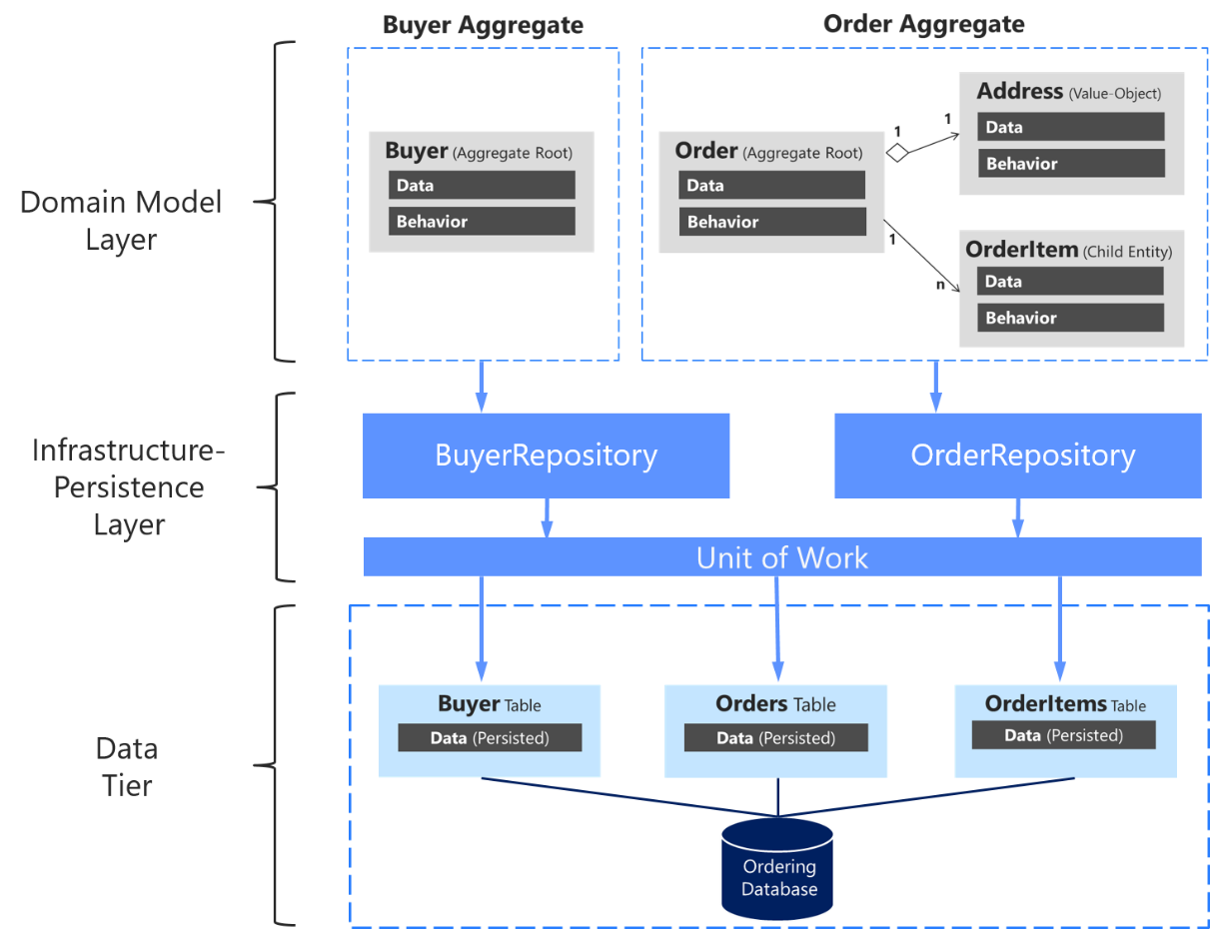
What is repository design pattern
The Repository pattern is a Domain-Driven Design pattern intended to keep
persistence concerns outside of the system's domain mode
What is the function of repository pattern?
The repository pattern is a design pattern that isolates the data layer from the rest of the app.
The data layer refers to the part of your app, separate from the UI, that handles the app's data and business logic, exposing consistent APIs for the rest of your app to access this data.

Slide 2
Microsoft.EntityFrameworkCore
Microsoft.EntityFrameworkCore.SqlServer

Slide 3
Emp Dept
public class Employee
{
public int Id { get; set; }
[Required]
[DisplayName("Employee Name")]
public string? Name { get; set; }
[Required]
[DataType(DataType.EmailAddress)]
public string? Email { get; set; }
[DisplayName("Department Id")]
public int DepartmentId { get; set; }
[JsonIgnore]
public Department? Department { get; set; }
}
public class Department
{
public int Id { get; set; }
public string? Name { get; set; }
public ICollection<Employee>? Employees { get; set; }
}
public class AppdbContextRepository:DbContext
{
public AppdbContextRepository(DbContextOptions<AppdbContextRepository> options)
: base(options)
{
}
public DbSet<Employee> Employee { get; set; }
public DbSet<Department> Department { get; set; }
}

Slide 4
public interface IEmployeeService
{
Employee? GetEmployee(int Id);
IEnumerable<Employee> GetAllEmployee();
Employee Add(Employee employee);
Employee Update(Employee employeeChanges);
Employee? Delete(int Id);
IEnumerable<Department> GetAllDepartment();
}

Slide 5
using API_Two_Table.Models;
using API_Two_Table.Repository;
using Microsoft.EntityFrameworkCore;
namespace API_Two_Table.Services
{
public class SqlEmployeeService : IEmployeeService
{
private readonly AppdbContextRepository context;
public SqlEmployeeService(AppdbContextRepository context)
{
this.context = context;
}
public Employee Add(Employee employee)
{
context.Employee.Add(employee);
context.SaveChanges();
return employee;
}
public Employee? Delete(int Id)
{
Employee? employee = context.Employee.Find(Id);
if (employee != null)
{
context.Employee.Remove(employee);
context.SaveChanges();
}
return employee;
}
public IEnumerable<Department> GetAllDepartment()
{
return context.Department;
}
public IEnumerable<Employee> GetAllEmployee()
{
return context.Employee.Include(dpt => dpt.Department).ToList();
}
public Employee? GetEmployee(int Id)
{//context.Employee.Find(Id);
Employee e = context.Employee.FirstOrDefault(m => m.Id == Id);
return e;
}
public Employee Update(Employee employeeChanges)
{
Employee e1 = context.Employee.FirstOrDefault(m => m.Id == employeeChanges.Id);
context.Entry(e1).State = EntityState.Detached;
context.Update(employeeChanges);
context.SaveChanges();
return employeeChanges;
}
}
}

Slide 6
using API_Two_Table.Models;
using API_Two_Table.Services;
using Microsoft.AspNetCore.Mvc;
namespace API_Two_Table.Controllers
{
// For more information on enabling Web API for empty projects, visit https://go.microsoft.com/fwlink/?LinkID=397860
namespace APIdemo1.Controllers
{
[Route("api/[controller]")]
[ApiController]
public class EmployeeController : ControllerBase
{
IEmployeeService employeeService;
public EmployeeController(IEmployeeService employeeService)
{
this.employeeService = employeeService;
}
// GET: api/<EmployeeController>
[HttpGet]
public IEnumerable<Employee> Get()
{
return employeeService.GetAllEmployee();
}
// GET api/<EmployeeController>/5
[HttpGet("{id}")]
public Employee Get(int id)
{
return employeeService.GetEmployee(id);
}
// POST api/<EmployeeController>201 created
[HttpPost]
public ActionResult Post([FromBody] Employee emp)
{
employeeService.Add(emp);
return CreatedAtAction("Get", new { id = emp.Id }, emp);
}
[HttpPut("{id}")]
public void Put(int id, [FromBody] Employee emp)
{
if (id != emp.Id)
{
// return BadRequest("The ID in the URL does not match the ID in the request body.");
}
Employee e1 = employeeService.GetEmployee(id);
if (e1 != null)
{
employeeService.Update(emp);
}
// return NoContent();
}
// DELETE api/<EmployeeController>/5 401 nocontent
[HttpDelete("{id}")]
public void Delete(int id)
{
Employee e1 = employeeService.GetEmployee(id);
if (e1 != null)
employeeService.Delete(id);
}
}
}
}

Slide 7
using APIdemo1.Repository;
using APIdemo1.Service;
using System.Text.Json.Serialization;
using Microsoft.EntityFrameworkCore.SqlServer;
using Microsoft.EntityFrameworkCore;
namespace APIdemo1
{
public class Program
{
public static void Main(string[] args)
{
var builder = WebApplication.CreateBuilder(args);
// Add services to the container.
builder.Services.AddControllersWithViews()
.AddJsonOptions(options =>
options.JsonSerializerOptions.ReferenceHandler =
ReferenceHandler.IgnoreCycles);
builder.Services.AddDbContextPool<AppdbContextRepository>(
options => options.UseSqlServer(builder.Configuration.GetConnectionString("EmployeeDBConnection"))
);
builder.Services.AddScoped<IEmployeeService, SqlEmployeeService>();
// Learn more about configuring Swagger/OpenAPI at https://aka.ms/aspnetcore/swashbuckle
builder.Services.AddEndpointsApiExplorer();
builder.Services.AddSwaggerGen();
var app = builder.Build();
// Configure the HTTP request pipeline.
if (app.Environment.IsDevelopment())
{
app.UseSwagger();
app.UseSwaggerUI();
}
app.UseHttpsRedirection();
app.UseAuthorization();
app.MapControllers();
app.Run();
}
}
}

Slide 8
{
"Logging": {
"LogLevel": {
"Default": "Information",
"Microsoft.AspNetCore": "Warning"
},
"Debug": { // Debug provider.
"LogLevel": {
"Default": "Information" // Overrides preceding LogLevel:Default setting.
}
},
"Console": {
"IncludeScopes": true
}
},
"ConnectionStrings": {
"EmployeeDBConnection": "Data Source=(localdb)\\ProjectModels;Initial Catalog=Demoempdept;Integrated Security=True"
},
"AllowedHosts": "*"
}

Slide 9
Install-Package Microsoft.VisualStudio.Web.CodeGeneration.Design -Version 7.0.0
This package helps create database context and model classes from the database.
Install-Package Microsoft.EntityFrameworkCore.Tools -Version 7.0.0
Database provider allows Entity Framework Core to work with SQL Server.
Install-Package Microsoft.EntityFrameworkCore.SqlServer -Version 7.0.0
var author = new Author
{
FirstName = "William",
LastName = "Shakespeare",
Books = new List<Book> { new Book { Title = "Hamlet"},
new Book { Title = "Othello" },
new Book { Title = "MacBeth" }
}
};

Slide 10
POCO class
using System.ComponentModel.DataAnnotations;
public class Book
{
[Key]
public int BookId { get; set; }
[MaxLength(25)]
[MinLength(6, ErrorMessage = "title must be at least 6 characters long")]
public string? Title { get; set; }
public int AuthorId { get; set; }
[Required(ErrorMessage = "ISBN Required")]
public string? Isbn { get; set; }
}
public class Author
{
public int AuthorId { get; set; }
public string? FirstName { get; set; }
public string? LastName { get; set; }
}
public class AppdbContext : DbContext
{
public AppdbContext(DbContextOptions<AppdbContext> options) : base(options)
{
}
protected override void OnModelCreating(ModelBuilder modelBuilder)
{
modelBuilder.Entity<Book>()
.HasOne<Author>() // Book has one Author
.WithMany() // Author has many Books
.HasForeignKey(b => b.AuthorId)
.OnDelete(DeleteBehavior.Cascade); // Optional: cascade delete
base.OnModelCreating(modelBuilder);
}
public DbSet<Book> Books { get; set; }
public DbSet<Author> Authors { get; set; }
}
configuring a one-to-many relationship between Book and Author using Fluent API in Entity Framework Core.
public interface IBookRepository
{
Task<Book> AddAsync(Book book);
Task<Book?> GetByIdAsync(int id);
Task<List<Book>> GetAllAsync();
Task<Book?> UpdateAsync(int id, Book updatedBook);
Task<Book?> DeleteAsync(int id);
}
Add-Migration
Update-Database

Slide 11
modelBuilder.Entity<Book>()
.HasOne(b => b.Author) // Navigation property in Book
.WithMany(a => a.Books) // Navigation property in Author
.HasForeignKey(b => b.AuthorId)
.OnDelete(DeleteBehavior.Cascade);
public class Book{
public int Id { get; set; }
public string Title { get; set; }
public int AuthorId { get; set; } // Foreign key
public Author Author { get; set; } // Navigation property
}
public class Author{
public int Id { get; set; }
public string Name { get; set; }
public ICollection<Book> Books { get; set; } // Navigation property
}

Slide 12
using AsynctwotableAPI.Models;
using AsynctwotableAPI.Repository;
using Microsoft.EntityFrameworkCore;
using AsynctwotableAPI.Services;
namespace AsynctwotableAPI.Services
{
public class SqlBookRepository : IBookRepository
{
private readonly AppdbContext _context;
public SqlBookRepository(AppdbContext context)
{
_context = context;
}
public async Task<Book> AddAsync(Book book)
{
await _context.Books.AddAsync(book);
await _context.SaveChangesAsync();
return book;
}
public async Task<Book?> GetByIdAsync(int id)
{
return await _context.Books.FindAsync(id);
}
public async Task<List<Book>> GetAllAsync()
{
return await _context.Books.ToListAsync();
}
public async Task<Book?> UpdateAsync(int id, Book updatedBook)
{
if (id != updatedBook.BookId)
return null;
var existingBook = await _context.Books.FindAsync(id);
if (existingBook == null)
return null;
_context.Entry(existingBook).CurrentValues.SetValues(updatedBook);
await _context.SaveChangesAsync();
return existingBook;
}
public async Task<Book?> DeleteAsync(int id)
{
var book = await _context.Books.FindAsync(id);
if (book == null)
return null;
_context.Books.Remove(book);
await _context.SaveChangesAsync();
return book;
}
}
}

Slide 13
public ActionResult<IEnumerable<dynamic>> GetName(string name)
{
var q = context.Books.Join(context.Authors, authid => authid.AuthorId, bkid => bkid.AuthorId, (bkid, authid) => new { Title = bkid.Title, Firstname = authid.FirstName }).Where(bk=>bk.Title==name);
return q.ToList();
}
Can I Use RawSql?
public async Task<ActionResult<IEnumerable<Book>?>> GetAllBook()
{
if (context.Books == null)
{
return null;
}
//context.Books.ToListAsync();
return await context.Books.FromSqlRaw("SELECT BookId, Title, AuthorId, Isbn FROM Books").ToListAsync();
}

Slide 14
using AsynctwotableAPI.Models;
using Microsoft.AspNetCore.Mvc;
using AsynctwotableAPI.Services;
namespace AsynctwotableAPI.Controllers
{
[ApiController]
[Route("api/[controller]")]
public class BookController : ControllerBase
{
private readonly IBookRepository _bookRepository;
public BookController(IBookRepository bookRepository)
{
_bookRepository = bookRepository;
}
// GET: api/book
[HttpGet]
public async Task<ActionResult<IEnumerable<Book>>> GetAllBooks()
{
var books = await _bookRepository.GetAllAsync();
return Ok(books);
}
// GET: api/book/{id}
[HttpGet("{id}")]
public async Task<ActionResult<Book>> GetBookById(int id)
{
var book = await _bookRepository.GetByIdAsync(id);
if (book == null)
return NotFound();
return Ok(book);
}
// POST: api/book
[HttpPost]
public async Task<ActionResult<Book>> AddBook(Book book)
{
var createdBook = await _bookRepository.AddAsync(book);
return CreatedAtAction(nameof(GetBookById), new { id = createdBook.BookId }, createdBook);
}
// PUT: api/book/{id}
[HttpPut("{id}")]
public async Task<ActionResult<Book>> UpdateBook(int id, Book book)
{
var updatedBook = await _bookRepository.UpdateAsync(id, book);
if (updatedBook == null)
return NotFound();
return Ok(updatedBook);
}
// DELETE: api/book/{id}
[HttpDelete("{id}")]
public async Task<ActionResult<Book>> DeleteBook(int id)
{
var deletedBook = await _bookRepository.DeleteAsync(id);
if (deletedBook == null)
return NotFound();
return Ok(deletedBook);
}
}
}

Slide 15
using AsynctwotableAPI.Repository;
using AsynctwotableAPI.Services;
using Microsoft.EntityFrameworkCore;
namespace AsynctwotableAPI
{
public class Program
{
public static void Main(string[] args)
{
var builder = WebApplication.CreateBuilder(args);
// Add services to the container.
builder.Services.AddControllers();
var b = builder.Configuration.GetConnectionString("BookDatabase");
builder.Services.AddDbContextPool<AppdbContext>((op) => op.UseSqlServer(b));
builder.Services.AddTransient<IBookRepository, SqlBookRepository>();
// Learn more about configuring Swagger/OpenAPI at https://aka.ms/aspnetcore/swashbuckle
builder.Services.AddEndpointsApiExplorer();
builder.Services.AddSwaggerGen();
var app = builder.Build();
// Configure the HTTP request pipeline.
if (app.Environment.IsDevelopment())
{
app.UseSwagger();
app.UseSwaggerUI();
}
app.UseHttpsRedirection();
app.UseAuthorization();
app.MapControllers();
app.Run();
}
}
}
"ConnectionStrings": {
"BookDatabase": "Data Source=(localdb)\\ProjectModels;Initial Catalog=tempdb;Integrated Security=True;"
}

